Slide 1
Lecture 1: Introduction to Computer Design Problems
Dr. Tsung-Wei Huang
Department of Electrical and Computer Engineering
University of Utah, Salt Lake City, UT
Notes:
Good morning, everyone. Welcome to ECE 5960 section 25 - special topic for advanced programming for computer design problems. I am the course instructor Tsung-Wei Huang, and you can just call me TW, which is much easier to remember.
I am faculty member at ECE department and my office is just right on this floor 2124 nearby the department office. Thanks for taking this course and I think this is a very good size in terms of open learning. I believe we will have another 3-4 students who will be coming next week, but I definitely wanna control the size within 10 students.

Slide 2
The course teaches you how to write “good” programs with a specific focus on solving computer design problems. You will gain “hands-on” experience in writing C++/Python code for implementing important data structures and algorithms …
Notes:
This course is going to teach you how to write "good" programs with a specific focus on solving computer design problems. For example, placing a bunch of electronic components on a very small area, finding the optimal routing connections between these components such that the chip can run as fast as possible, or using some advanced techniques such as machine learning, parallel processing, to make the design cycles run as fast as possible. And you can imagine that, today's complexity is very large, and I am talking about billions of transistors. If you wanna do that all by hand, it is like ... have a nice day. (explore)
So, we need this process to be automated. and what we mean by automation is software method, computer-aided design (CAD). We write software program to do this for us because computer runs much faster than human brain in calculation. And we will focus a lot on these software methods in this course. Most importantly, you will gain ...

Slide 3
Advanced Applied Programming for Computer Design Problems
Notes:
This is a very practical course. It is not a theory, it has a lot to do with software engineering. In fact, when I submit this course to the department, I intend to do "applied programming for computer design problems" rather than "advanced" which is a bit scary. Then the department said well you know we have many outstanding students and we probably should make it advanced, but... anyway.
So, again, this will be a practical course that teaches you a bunch of algorithm and data structure that are commonly used in solving the computer design problems. The goal is to learn how to code by applications.

Slide 4
Class Logistics
Staff
Instructor: Dr. Tsung-Wei Huang
TA: I will be helping you in person ☺
When/where to meet
3:30 AM – 6:30 PM every Thursday (excluding holiday)
MEB 2555
Office hour
Tsung-Wei Huang: 1-3 PM every Wed (MEB 2124)
Feel free to email for additional appointments
Web: https://github.com/tsung-wei-huang/ece5960
Notes:
class logistics. We have one instructor which is myself. There is no TA and I will be helping you in person. We will meet once a week every Thursday here at MEB 2555. But there might be a chance we need to change the room because the projector was broken. And the department hopes it will get fixed by next class. Well, I hope ... The reason I am using this room is computers. We will do in-class programming practice with these computers. Let me ask, how many of you do not have a laptop...if we change to another class room without computers.
You can find me at my office hour, every Friday from 1 to 3 pm at MEB 2124, that is a room nearby the main department office. You can also meet me by appointment.
Webpage. We will use GitHub to manage the class. You can go visit the page or find the link at the my website. You can check out the class materials from the repository. We use GitHub because it allows everybody to easily keep track of all changes and updates to the class materials.

Slide 5
Scoring
Total 100 points
In-class programming practice: 40 points
Programming Assignment 1: 20 points
Programming Assignment 2: 20 points
Programming Assignment 3: 20 points
NO EXAM
Academic integrity
We trust you but don’t take it for granted
Violation will be recorded in your transcript
https://regulations.utah.edu/academics/6-400.php
Notes:
In terms of scoring, there will a total of 100 points with a major part going to in class programming practice. We will have three "official" programming assignment each accounts for 20 points. There is no EXAM. I personally don't think it's a good idea to have an exam for programming. It's not something you can write down on a paper but the ability to find solutions based on your knowledge, skills, and internet. Do you ever see a person writing code and somebody say hey you can't use internet or reference manual? It's stupid. So, there is no EXAM. You need to write code in order to learn programming.
For me, being able to find the solution from the right sources is actually more important.
Of course, there shouldn’t be any cheating especially in the assignment. You cannot copy the solution from others or from your friends. Every body has his or her own coding style and convention, right? You may name a variable in a way that is completely different from others or structure your code in your own taste. It's easy to find someone cheating if you just copy and paste solutions from somewhere.

Slide 6
Learning Materials
You DON’T NEED to buy any textbook
Slides will be available and are enough
Notes:
Reference book.In this class, you don’t need a reference book. Slides will be available to the GitHub and are quite enough. Like I said, the most important materials are the programming practice questions we are going to do in each class.

Slide 7
Class Philosophy
Focus on software programming
With applications on computer design problems
Code review and refactor
NOT to trouble you with
Difficult homework
Tricky exams
Unreasonable learning and scoring curve
At the end of the class, I want you to
Understand important computer design problems
Improve your coding skills and algorithm knowledge
Have more job opportunities in software companies
Notes:
Philosophy of the class. This class is going to focus on software programming a lot, with applications on solving computer design problems. At the same time, we want you to become a good programmer. A good programmer means a lot. It is not just writing fast code with good algorithms and efficient data structure, but also the ability to let people use, read, and reproduce your idea. If you want to become a good programmer, you can't just sit in front of your own editor and write code, you must work with other. You have to see how others code and structure their software, right? It's just like learning a new language. If you don't speak with a native speaker, you are not going to make it. So, we will do code review and refactor for most of the programming practice questions. In the first version of your code, it might look very ugly and inefficient. Now you need to take a look at others solutions and see if there are something you can learn from. This is the essence of becoming a good programmer.
So, this class is definitely not going to trouble you with ... (articulate the following items)

Slide 8
To this end
Each class is organized as two parts
Lecture
Programming practice
We will start from very basic stuff and then move up
Important data structure and algorithms
Important C++ coding techniques and best practice
Solve real-world computer design problems in C++
Circuit partition
Layout floorplanning
Machine learning
…
Notes:
To make this happen, each class is organized to two parts. First part will be a normal lecture, you know, cover some essential concepts, algorithm, data structures, and computer design problems and applications. Second part will be programming practice. I will design relevant questions to these concepts as programming practice. You will need to work on those questions, write code, and apply the class knowledge to the actual implementation. Then we will do code review and refactor together. We will learn from code.
So, we will start from the very basic stuff and then move up to those topics commonly used in computer designs. We will spend time on learning important data structure and algorithms. ...
We will solve real-world computer design problems using C++, including circuit partition, ...

Slide 9
Utah CADE Machines
All of you should have access to CADE servers
If not, go apply for one at: https://www.cade.utah.edu/
CADE machines have all the facilities we need
Domain: labX-Y.eng.utah.edu
X = 1, 2, 3, … (# of lab space)
Y = 1, 2, 3, 4, 5, … (machine # of each lab space)
For example, lab2-20.eng.utah.edu
Account: your uid
Password: your uid login password
Remote login using ssh (the easiest way)
ssh -x u6024634@lab2-20.eng.utah.edu
Notes:
Programming environment will be on utah CADE machine. ...

Slide 10
Login using NoMachine
Demo

Slide 11
Software Engineer Job Landscape
Notes:
Like I said, this class is essentially a software class. Many of you already know, software is becoming more and more important these days. Literally all the jobs require some levels of programming, right? Even though you are doing like chemistry or physics experiments, you need to write programs running simulation so you can avoid spending unnecessary efforts.
this is a map that just shows you the software engineer job opportunities and salary numbers across different states in the united state. The average number is all above 100K and that is actually very high, and this is the average rate for undergraduate. If you are in a really high-tech company and with a MS or PhD degree, the salary number is even higher. For example, a fresh graduate joining Google has a base around 150K. and this is the number I remember two years ago. If it is a financial company, for example, it is even higher. When I got my phd from UIUC, the university of illinois at Urbana-Champaign, I received an offer from Citadel. It's a financial firm, the dark side of technology. The total compensation for the first year was above 300K. It's really high.
But, money is not always the most important factor in deciding a job. It's all about your personal interests. Otherwise, I won't be here. Anyway, what I am showing here is, software engineer has a good pay, and it is not just about the number, it's where people really care. it's the place where people find interesting and worth investing, because there are real problems and challenges to solve. I worked for IBM, Mentor Graphics, EDA companies, and financial firms. I do think being able to explore different opportunities, especially software companies, is an excellent thing. (share more and discuss with students)

Slide 12
Top 10 Programming Languages
Notes:
This slides shows the top 10 programming languages from IEEE summarized from last year 2019. The programming languages on the list are python, C, Java, C++, C#, R, JAvaScript, PhD, Go, and swift. ...
The takeaway here is, there are many programming languages, which one should I learn? Well, I think, the question usually depends on what kind of applications you want to do. For example, we have the so-called front-end development, like web, smart phone, app, and those applications have their own language zone. For back-end development, like the engine that actually supports the things to happen, you know like when you open the browser, there are a bunch of things happening on the background, those are the backend development. And C++ is definitely one of the most popular choices. In fact, most of the computer engineering problems and computer design problems are written in C++.
(share more and discuss with students)

Slide 13
Targeted Programming Language
We will be using C++ most of the time
Most large-scale problems are written in C/C++
Most AI backend engines are written in C/C++
Most performance-critical blocks are written in C/C++
C++ is advantageous in
Being both high-level and low-level
Linking to hardware and computer architecture
Understanding memory hierarchy and cache effect
Notes:
So, the targeted programming language of this course is C++. ...
Any questions so far?

Slide 14
What are computer design problems?
Notes:
The course is "applied" programming for computer design problems. But, what are computer design problems?

Slide 15
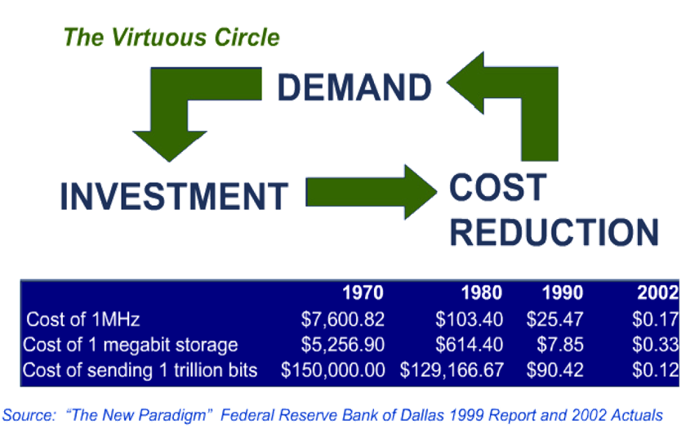
System Design Lifecycle
Notes:
This is the typical computer system design lifecycle. You start with a demand and come up with a spec, listing out all the functionalities you need. For example, it can be as large as a server, a car, a drone, or as small as the smart phone, micro controller, IoT devices and PCB board.
Then you invest money to design the chip for the system you want. This can be a prototype or an experimental products. If things work out very well, you want to do massive production, you want to sell the product and make profits. How do you make money? Well, you need to reduce and control the cost.
After a while, you come back with a new demand from the market that has more powerful features and functionalities. Then you invest in developing another new system and repeat the cycle over and over.

Slide 16
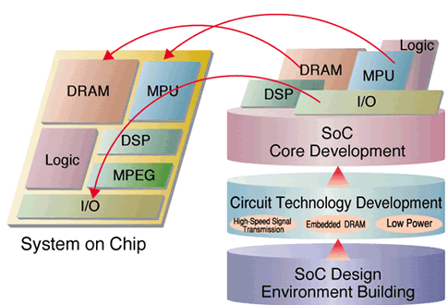
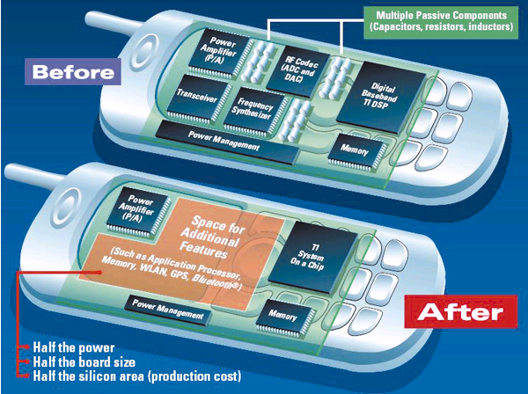
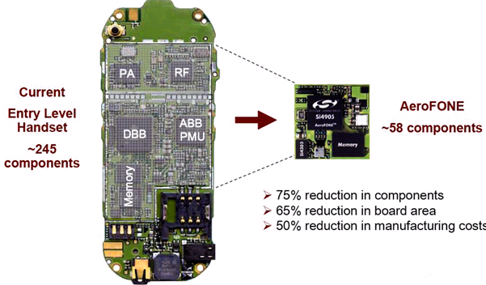
Very Large Scale Integration (VLSI)
Improve performance, power, and area
Smaller chip also improves the power, cost, performance, and many other things
Notes:
This cycle gives rise to very large scale integration (VLSI). VLSI is the result of you want more and more functionalities with smaller and smaller devices. Essentially, you want the product to be more powerful with more functionalities and features, and you don’t want it to be too large, you want it to be portable small. No one wants to bring a cellphone with a size of table everyday.
In fact, smaller chips also improve the power, cost, performance, and many other things.

Slide 17
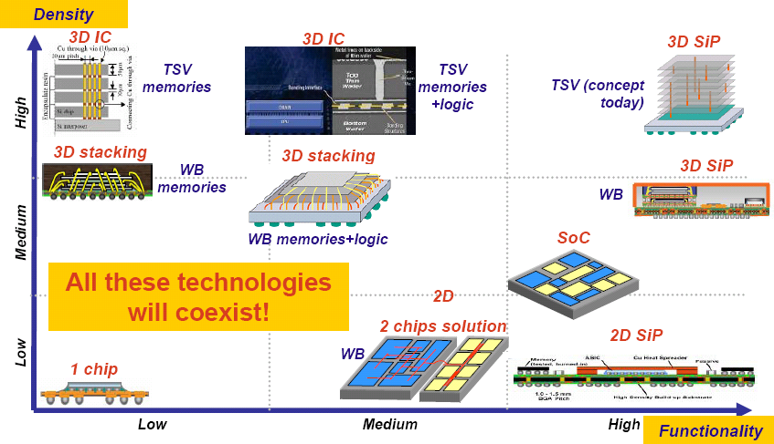
System on Chip or System in Package
Notes:
In addition to very-large scale integration, we are moving to a scale of system on chip or system in package. This is where you don’t want a single function per chip, but a system on the chip. The system can be for example, a Linux system running a particular application or other operating systems running applications for specific demands.
For example, you might have a FPGA board with a linux kernel system that you can log in to program the FPGA. And this is much easier than writing a FPGA program in a separate space and then copy the bit stream into the FPGA back and forth.

Slide 18
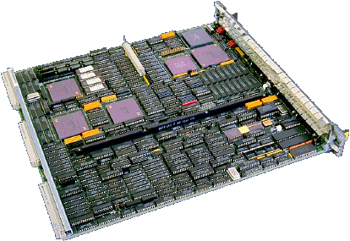
Miniaturization
Was Now…
PC on Chip
30 x 30 cm²/ 1kg 2 x 2 cm² / 10g
Notes:
Of course, miniaturization is a key enabler. It is always a good idea to keep things small and lightweight. We don’t want to bring large and dumb things all the time. That is not just very convenient. If you look at your smartphone, it comes with a camera. The camera is becoming more and more powerful from time to time, and the size of the camera is becoming smaller and smaller.

Slide 19
Trends of VLSI design
It must be simple and reusable
Notes:
At the demand for these devices continues to increase, we need to keep up with the market growth and performance scaling, designing a VLSI must follow the principle of being simple and reusable.
The challenge is the design complexity is so large today and we cannot afford too complex design methodologies, right, we cannot rely on humans to always design the chip by hands. So, being simple means we wants a systematic way and flow to design the chip. On the other hand, we have to keep reusability in mind. No one wants to always design the chip from the scratch or design each part of the chip over and over. Instead we want to be able to reuse our available resources and extend new values on top.

Slide 20
Representing a “Design”
Behavioral representation
Describes the functionality of a target
Structural representation
Describes the connectivity between components
Physical representation
Describes the layout, polygons, and spacing rules
Notes:
To reach this goal, the first thing is to think of a systematic way to represent a design. A design can be a chip, system, or any other electronics that must be manufactured by semiconductor. You know, the entire industry has been around for many years and accumulated years of experience from smart people. People came up with the following: beha … structural, and physical …
Essentially, behavioral representation describes the functionality of a target. It can be as simple as an adder or as complex as an operating system.
Structural representation describes the connectivity between components. A has to connect to B and B has to connect to C.
Physical representation describes the layout, polygons, and spacing rules. This is the way we actually use to tape-out and manufacture your design.

Slide 21
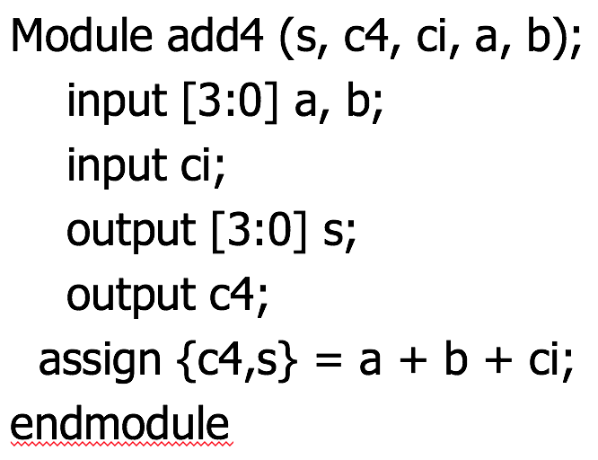
Behavioral Representation
High-level description language
System-C
System-Verilog
VHDL
Notes:
To represent the behaviors of a design, people invented a number of high-level languages, systemC, system-Verilog, and VHDL. These languages allow users to focus on high-level behaviors of their design.
For example, you want to create a 4-bit adder, an adder with four inputs.
In terms of a famous hardware description language verilog, you only need to specify the input, output, and the operators. (explain this example)
By looking at this code, we found there is no need for you to know anything about physical, layout, and how it is actually implemented. Everything you describe here is behavioral.
Now keep in mind, this kind of abstraction is playing a huge game in today's tech market. For example, tensorflow ...

Slide 22
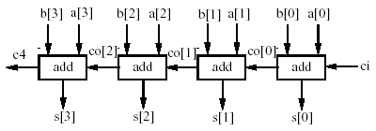
Structural Representation
Things are more concrete to implement the target
Gates
IP blocks
Notes:
The next level to behavioral representation is structural representation. This is where things start to become more clear and more concrete to implement the target. In the same 4-bit adder example, here you see a bunch of gates, IP blocks, or modules where you have a schematic view over the connection between these components. You start to see the structure of the implementation.
For example, (explain figure ...)

Slide 23
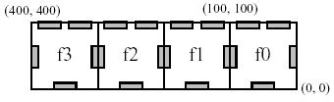
Physical Representation
The actual geometry to tape-out the target
Polygons
Metal layers
Spacing rules
Notes:
Finally we have physical representation which is the actual geometry to tape-out the target. As you can see, it has a bunch of polygons, metal layers, positions of each block, and spacing rules to describe the implementation details of your design.

Slide 24
The Design Style of Digital Circuits
Digital circuit’s signal is at either one or two levels
on/off, 0/1, true/false
Use transistors to create logic gates for Boolean ops
Notes:
There are many different design styles depending on the target circuit components, for example, digital circuits, analog circuits, and other custom accelerators. Now I am going to talk about the design style of digital circuits. And we will focus on digital circuits design problems because they are a major part of today's chip market.
A digital circuit is a circuit where the signal must be one of two discrete levels. Each level is interpreted as one of two different states (for example, on/off, 0/1, true/false). Digital circuits use transistors to create logic gates in order to perform Boolean logic. This logic is the foundation of digital electronics and computer processing.
For example, we can have AND gate, NAND gate, OR gate, NOR gate and so on.
These gates can be viewed as a set of mathematical functions that take a set of input in the domain 0 and 1, and gives an output in the same binary domain. A famous table to represent these functions is “truth table”. Here we can see an example.
A NOT gate, often called an inverter, has only a single input with simple behavior. A NOT gate performs logical negation on its input. In other words, if the input is true, then the output will be false. Similarly, a false input results in a true output.
An AND gate is a digital logic gate with two or more inputs and one output that performs logical conjunction. The output of an AND gate is true only when all of the inputs are true. If one or more inputs are false, then the output of the AND gate is false.
Similarly, an OR gate is a digital logic gate with two or more inputs and one output that performs logical disjunction. The output of an OR gate is true when one or more of its inputs are true. If all of an OR gate's inputs are false, then the output of the OR gate is false.
An XOR gate (sometimes referred to by its extended name, Exclusive OR gate) is a digital logic gate with two or more inputs and one output that performs exclusive disjunction. The output of an XOR gate is true only when exactly one of its inputs is true. If both inputs are false, or if both of its inputs are true, then the output

Slide 25
The Design Style of Digital Circuits
The rule of thumb (design principle)
Systematic
Reusable
Digital Circuit Implementation Approaches
Custom
Semicustom
Cell-based
Array-based
Standard Cells
Ma
cro Cells
Pre-diffused
Pre-wired
Compiled Cells
(Gate Arrays)
(FPGA's)
Notes:
Using these fundamental logic gates, we are able to design large digital circuits. There are many ways to design a digital circuit which we call “Design Style”. Whatever they are, the rule of thumb is also following the design principle of being systematic and reusable.
Being systematic is great because people in general don’t like messy designs. Being reusable is important because we don’t want to always design each part of the design from scratch.
There are many styles: custom design and semicustom design. Custom design essentially means everything is done by hand. Semicustom design, you design the chip with the help of computer and this is why we called it computer-aided design. Within semicustom design, you have cell-based design and array-based design. Cell-based design are used more for application specific domains and array-based design is more on the general-purpose side. On the left hand side, we usually call it ASIC, application specific integrated circuits. On the right hand side, we usually call it FPGA, filed-programmable gate array.

Slide 26
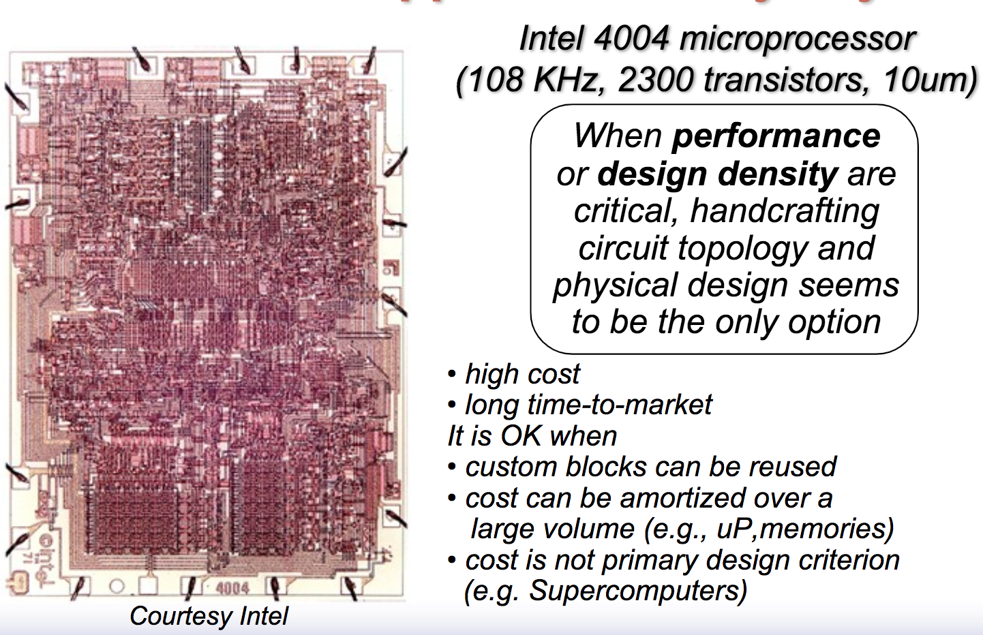
The Full-custom Approach (I)
Early day, people handcrafted everything …
Notes:
Full-custom design is a methodology for designing integrated circuits by specifying the layout of each individual transistor and the interconnections between them. This is an early day design style where people handcrafted everything. There is a very interesting fact. In the old day, when Intel was designing the CPU. You know, at that time, things are still small, thousands of transistors only. They asked a bunch of people, sitting in a closed room, laid down and unfolded a large paper, and people started to draw the layout of each component and transistor, and figure out the connection, and so on so forth. It worked in the early day because Intel has a lot of money and they can hire many people to do the hard work. I mean, it’s not a big deal if you consider only two thousand transistors with cpu speed at 100 K Hz.
When performance or design … But this is no longer true. Now we are talking about billions transistors. Doing this will take too much cost and long time-to-market.

Slide 27
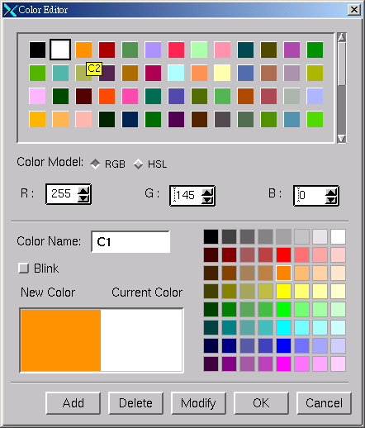
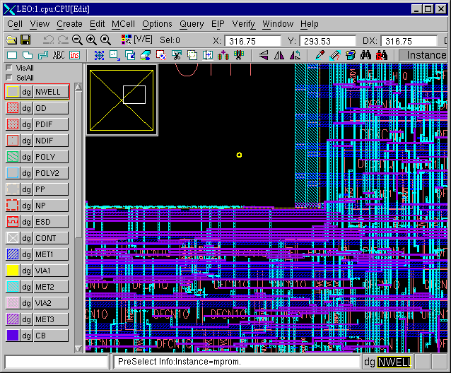
The Full-custom Approach (II)
Performance at transistor level
Utilize layout editing tools
Virtuoso (Cadence)
Laker (SpringSoft, now Synopsys)
Very expensive in design cost and design time
10-20 gates per week
Used for:
Analog
Leaf cells - libraries, memory cells
Datapath in high performance designs
Notes:
So the full-custom approach is to optimize the performance at transistor level. We use layout editing tools like Virtuoso by Cadence or Laker which was initially developed by SpringSoft and now is part of Synopsys’s tool. The full-custom approach is very expensive in design cost and design time. The productivity is very low. You can probably only design 10-20 gates per week.
But, people are still using this approach today, primarily for small scale design such as Analog circuits, leaf cell or memory cells, or datapaths in high-performance designs.

Slide 28
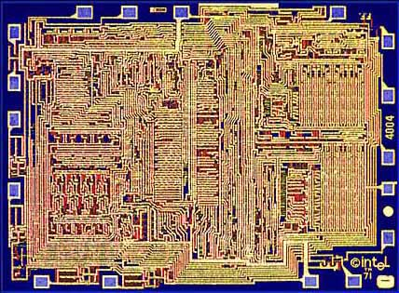
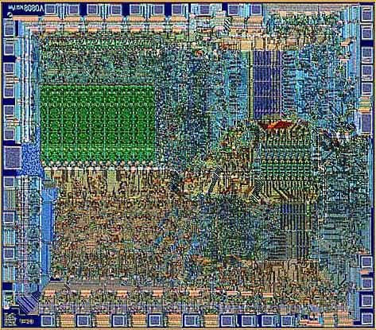
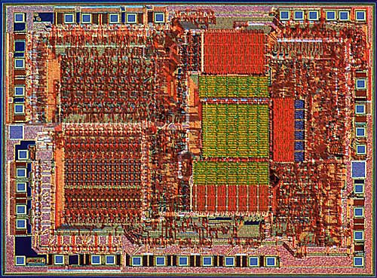
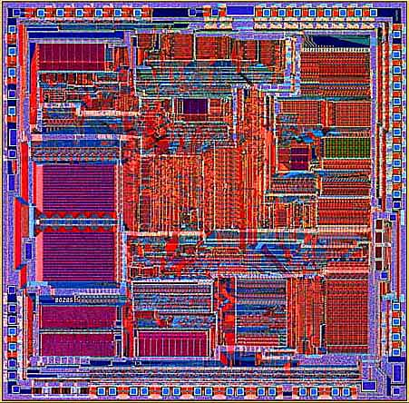
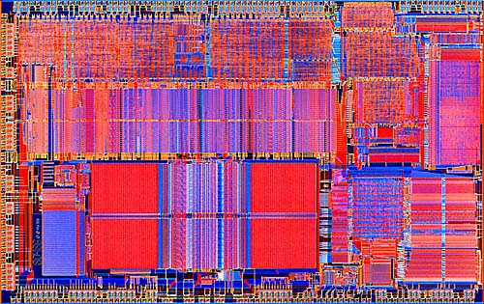
Toward Automation and Regular Structures
Intel 4004 (‘71)
Intel 8080
Intel 8085
Intel 8286
Intel 8486
Notes:
To improve the productivity and design cost, things are, fortunately, moving toward automation and regular structures. We don’t want to always design every part of the circuit from scratch. Instead, we wanna be able to reuse the existing resources and create new things on top. So, if you look at the Intel cpu evolution, from time to time, things become more modular and regular.
In Intel 4004, all you can see if nothing but a complex layout like a dust bunny. In 8080, chip becomes more structural. You can see a clear green box over there, representing the memory block I believe. In 8085, it’s even clearer. You can see a bunch of IO pad, datapath, memory block, and CPU. And Now in the series of 86, we can almost tell the architecture and layout of each important components by just looking at the figure.
..
Once we make things structural and modular, we are able to reuse many existing blocks and do powerful automation on top. People are willing to this because it actually can save a lot of design costs.

Slide 29
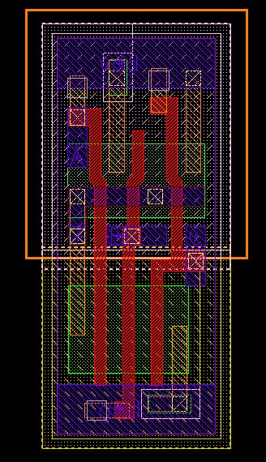
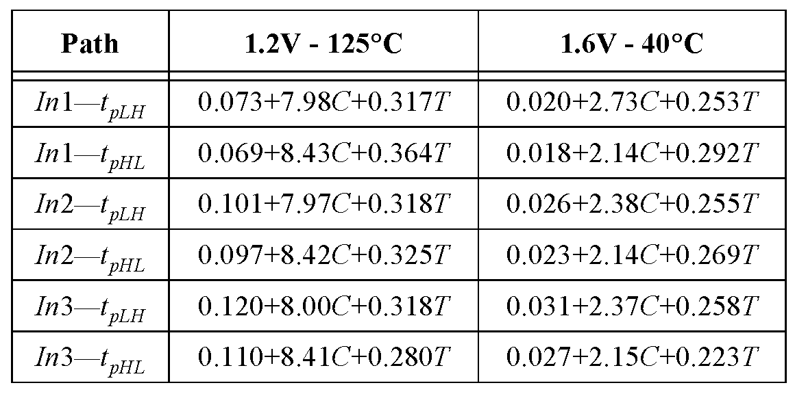
Reusability
Standard cell methodology
3-input NAND cell
(from ST Microelectronics):
C = Load capacitance
T = input rise/fall time
Notes:
A key enabler to modular design is the standard cells. Standard cell methodology is an example of design abstraction, whereby the design layout is encapsulated into an abstract logic representation such as the AND gate, OR gate, and NOT gate we discussed before.
The idea is, we want to come up with a common library, representable enough for composing generic functionalities, and we build out layout on top of this library.
The library is called “standard cell library”. Having a standard is always a good thing especially for designers, right.
When we design the chip, we can assume a good set of building blocks that had been properly designed by someone else, so we can skip all those details and fully focus on our job. (explain in software: This is very similar to for example, when you write a program, you will call some functions defined in a library, such as printf, square root, log, and you don’t need to rewrite those functions on your own with assembly code which can be very tedious.) We want to create values on top of existing resources. This is the idea of being systematic and reuseable.

Slide 30
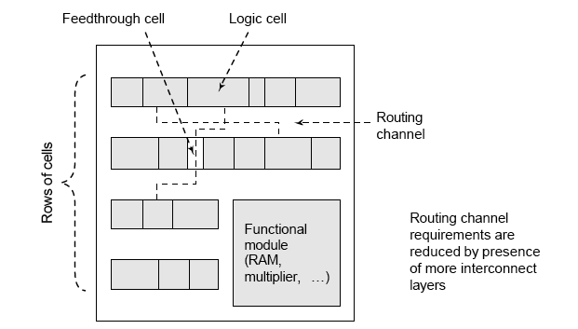
Cell-based Design
Notes:
This is an example of standard cell-based design. A standard cell often is nothing but a logic gate, like or gate, and gate, nor gate, and so on so furth. Each standard cell has a unique property. The height of every standard cell has the same value. This might not be true for particular libraries but in general this is what people intend to follow. When you are designing a chip layout, you will have multiple rows with the same height. Depending on the logic functions, you will need to fill in the rows with standard cells and establish the connection, called routing, such that the layout maps the target function. This is what we call “cell-based” design. Now you can see, because of this regular structure, we are able to formulate the problem in to an optimization problem and minimize for example the area, routing length, and placement congestion.

Slide 31
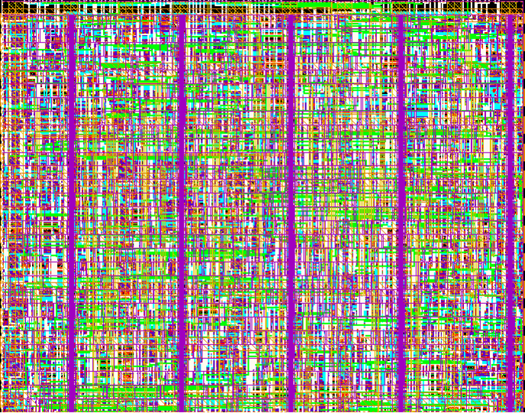
The New Generation of Standard Cells
Cell-structure
hidden under interconnect layers
Notes:
This is an example of standard cell design.
…

Slide 32
Advantages of Standard Cells
Cells are characterized and stored in library
Standard cells: FFs, AND, OR..
Macro cells: Memory, PLA, ALU…
Need update when technology advances
Easier to develop CAD tools for optimization
Design process is simplified
Manufacturing process is not simplified
Manufacturing chips is never easy …
Notes:
There are many advantages of standard cell design.
.

Slide 33
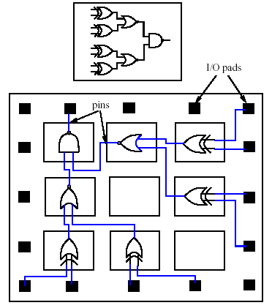
Gate Array Design Style
Arrays and sites are pre-manufactured
NAND/NOR gates already there
Just need to deal with wiring
Reduces production cost
Notes:
Another design style is gate array design style. The previous design style is pretty much handcrafted for an application. (explain and then bring up the application specific integrated circuits ASIC). What this means is you are not able to change the functionality after the chip is manufactured. It is there after tapeout. You can't ask it to do other things. For example, you can't change a micro controller in a car to like the flight engine.
To remedy this problem, we have another design style, gate array design style. A gate array is an approach to design a target using a prefabricated chip with pre-manufactured components such as logic gates and other memory blocks. These pre-fabricated gates provide a universal logic function ”under certain constraint”. You can reconfigure the design from time to time. All you need is to deal with the wiring. Essentially, you use some switching and multiplexing methods to make wiring reconfigurable. Every time you change the function, you will just need to come up with a new routing and wiring plan to implement the new function. The reconfigurability, of course, can largely reduce the design time, less chance of error, reduce production cost, faster time to market

Slide 34
Field Programmable Gate Array (FPGA)
Arrays of programmable modules with the capability of implementing a generic logic function
Wires can be connected by programmable connection boxes (CB) and switch boxes (SB)
Reduce development and production time
Low cost prototyping
Notes:
A very famous example of gate-array design style is FPGA, filed programmable gate array.
…
…
It’s worth mentioning FPGA is becoming really popular today because of machine learning and AI. In machine learning, things keep changing, and it is changing faster than the speed we design an application specific circuit for a particular machine learning applications. For example, you may change the model every two weeks depending on which market you are in. And it is impossible to design an application specific circuit for only two weeks. So people are turning their attention to FPGA which provides a more flexible and reconfigurable environment to implement their machine learning system.

Slide 35
Comparison of Design Styles

Slide 36
Standard cell methodology enables reusability, modularity, and facilitate the process of computer-aided design (CAD) or electronic design automation (EDA)
Notes:
So, a key takeaway here is:
This is really important. Everything marked in red has very high chance to show up in the exam.

Slide 37
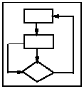
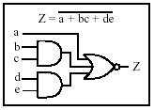
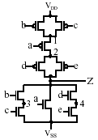
Standard-cell Design Automation Flow (I)
functional
simulation
logic
simulation
circuit
analysis
extract &
verification
System
Specification
Functional /
Architecture
Design
RTL & Logic
Synthesis
Circuit
Design
module fz(a,b,c,d,e,Z);
input a,b,c,d;
output Z;
assign Z =
~(a|(b&C)|(d&e));
endmodule
behavior
representation
HDL description
gate-level
representation
switch-level
representation
Notes:
Now I am going to talk about the design automation flow for standard cell design. This will be the place of most computer design problems we are going to talk about in this course.
A typical computer system design flow looks like this:

Slide 38
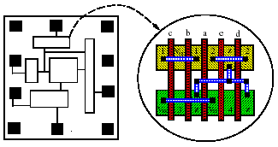
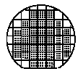
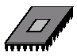
Standard-cell Design Automation Flow (II)
extract &
verification
GDSII
files
Physical
Synthesis
Fabrication
Packaging

Slide 39
Physical Design Details
Notes:
This slide gives you a detailed flow chart of physical design. It’s a master piece of work and consists of many complex steps. VLSI design automation has many of the most challenging computational problems in the world.
(1. explain... 2. bring up the google map team)

Slide 40
Hardware Description Language (HDL)
A “language” to describe a deign
The structure of a system
Different methods to achieve a function
Logical structures that perform the architecture
Can describe the design at some levels of abstraction
Behavioral, structural, gate-level
Can be used to document the system
Simulation results
Functionalities report
Notes:
Like software programming language, we have hardware description language (HDL).
A famous example is Verilog where you can use it to programmatically decide the structure of a system, implement different methods to achieve a function, and describe the logic structures that perform the architecture.
It can describe the design at some levels of abstraction …
Also, you can use it to document the system.
Again, like I said, this is very similar to any software programming language.
..

Slide 41
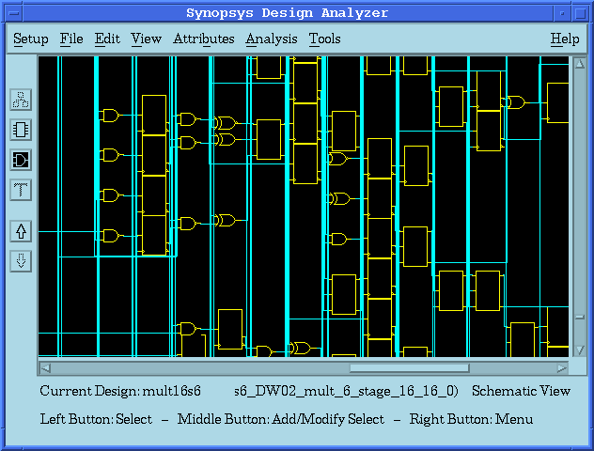
RTL/Logic Synthesis
Translate an HDL source code into a netlist
Technology independent optimization (logic minimization)
Bind the netlist with user specified cell libraries (technology mapping)
Technology dependent optimization
Supported synthesis tools:
HDL/Design Compiler (Synopsys)
RTL Compiler (Cadence)
Notes:
After you write up the code that describes the behaviors of the design, the first step in the automation is to perform logic synthesis.
We translate … A netlist is nothing but a connection description of all cells. some cell connects to the other and another connects to another.
Synthesis with no optimization is completely a trash. (right, otherwise you can just draw randomly). We want to optimize the performance of our product. Performance means area, size, power, timing, and speed. So within the process we have many optimizations happening such as …
Some example tools include …

Slide 42
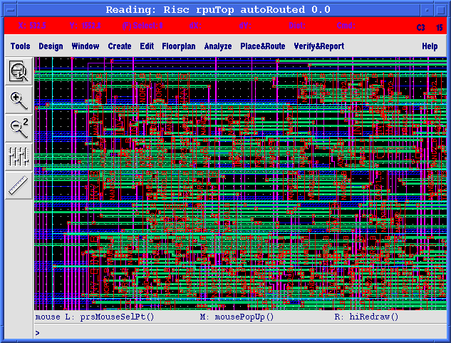
Physical Synthesis
Transform a gate-level netlist into a layout
Place circuit components
Route wires
Transform into a mask (GDSII file)
Supported P&R tools:
Silicon Ensemble (Cadence)
Apollo (Synopsys)
SOC Encounter (Cadence)
Blast Fusion (Magma)
Notes:
The next step after logic synthesis is physical synthesis. This is a step to transform a gate-level netlist into a physical layout.
You place the circuit …

Slide 43
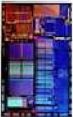
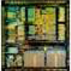
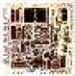
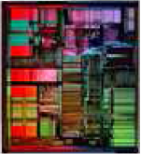
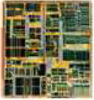
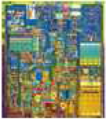
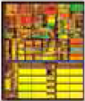
Design Automation is Driving Chip Evolution
1982 – Intel 80286
134K transistors
12MHz; 68.7 mm²
1985 – Intel 80386
275K transistors
33MHz; 104 mm²
1989 – Intel 80486
1.2M transistors
50MHz; 163 mm²
1993 – Intel Pentium
3.1M transistors
66MHz; 264 mm²
1997 – Intel Pentium II
7.5M transistors
300MHz; 209 mm²
1999 – Intel Pentium III
28M transistors
733MHz; 140 mm²
2000 – Intel Pentium4
42M transistors
1.5MHz; 224 mm²
Notes:
This slides show the evolution of Intel CPU, and you can clearly see design automation is driving chip evolution. From time to time, chips are becoming more and more complex.
If you can imagine, standing outside the sale lake, you take out a piece of hair, about a hundred micron in thickness, you put that down in front of you, and you continue ripping out the hair across the lake, which is like what chip design is. That’s kind of the length of wiring we have today on a chip. If a single piece of hair get out of place, you just destroyed the entire chip; you just lost a hundred million dollars.
That’s the mentality. This is brutal, right.

Slide 44
Automation is an Optimization
Automation with no optimization has no value
Of course, why are you wasting time!?
Optimization aims to outperform manual designs
Too much expensive to rely on human
Want the process to be automated
Objectives
Low Power
Faster timing
Smaller area
…
Notes:
Design automation is all about optimization. We want to optimize the results. We want our product to perform the best.
(explain items)

Slide 45
There is NO Perfect Solution
Area
Area
Area
Area Max
Cycle-time
Latency
Latency
Latency
Latency Max
Notes:
Keep in mind there is no perfect solution. Sometimes you want A to the best, and B might drop down because of A's improvement. For example, if you want to optimize the timing, you may increase the size of cells. That means you need to sacrifice the area of the chip. Increasing the size of the cell may also have impact on the power too. Similarly, if you want a low power design, you may not be able to make it too small because if everything get together in a small area, it becomes too compact, and you will run into the power disapation problem.
It's like, a shortest route might require you to go across the mountain but it takes a lot of energy to do so. and you may decide to make a detour even though it takes longer time for you to reach the goal.

Slide 46
We will Learn How to Make Trade-offs
Multi-criteria optimization
Pareto points
Heuristics
Parameter tuning
…
Notes:
In most of the design automation problems, there are no uniquely optimal solutions. We need to stop the optimization at some points to avoid other major design concerns from coming out.
So, we will learn how to make trade-offs in this course.

Slide 47
How to make a tradeoff though?
Notes:
…

Slide 48
You Need to Know Algorithms …
Exhaustive search: Search the entire solution space.
Branch and bound: A search technique with pruning.
Greedy method: Pick a locally optimal solution at each step.
Dynamic programming: Partition a problem into a collection of sub-problems, the sub-problems are solved, and then the original problem is solved by combining the solutions.
Simulated annealing: An adaptive, iterative, non-deterministic algorithm that allows “uphill” moves to escape from local optima.
Multilevel framework: The bottom-up approach followed by the top-down one; good for handling large-scale designs.
Mathematical programming: A system of solving an objective function under constraints.
Notes:
Well, you need to know algorithms. Simply put, algorithm is way we use to solve a computational problem. It can affect the efficiency of your program, and the correctness of your results.
There are many algorithm paradigms to deal with these difficult computer design problems. (explain ... )

Slide 49
In-class Practice 1
Big Mod
Input: a, b, c (3<a, c<5000000, 1<b<2147483647)
Output: x = a^{b} (mod c)
Naïve method
for(i=1, j=1; i<=b; i++)
j = (j*a)%c;
printf("%d\n", j);
Problem of naïve method
need b iterations
Very slow execution for large b

Slide 50
Reflect on Big Mod Problem
Naïve method
2¹⁶ = 2*2*2*2*2*2*…*2 total 15 calculation
Can we do better?
Notes:
2¹⁶ = ( 2⁸ )² total 1 calculation
2⁸ = ( 2⁴ )² total 1 calculation
2⁴ = ( 2² )² total 1 calculation
2² = ( 2¹ )² total 1 calculation
2¹ = ( 2⁰ ) total 1 calculation

Slide 51
In fact, there is a name for the refined method:
Divide and Conquer algorithm
(used to solve >50% computer design problems, including Google’s distributed system solutions, e.g., MapReduce)
Notes:
…
This is really important. Everything marked in red has very high chance to show up in the exam.

Slide 52
Get a Sense of Runtime Performance
Time complexity analysis
Runtime plays the most important role in performance
In algorithm theory, we use big O worst case analysis
Upper bound of the runtime with respect to input size N
In this course, we will use TW’s empirical analysis as with modern computer architectures
Notes:
Everything we want to pursue here is performance. And the most important performance people care a lot is the runtime performance. the execution time of your program and algorithms. The elapsed time after I hit the button until I see the result.
To understand the runtime performance, you need to know how to analyze the time complexity of your algorithm, or the efficiency of your algorithm. In algorithm theory, we typically use big O worst case analysis. Mathematically, It is the "closest upper bound" of the runtime with respect to the input size N. For example, if your algorithm simply takes a linear scan over all input data, we say the complexity is O(N). of course you can also say it as O(N^2) but we care the "minimum upper bound", the "closest upper bound" to cover the complexity of your algorithm. (queestion: what is the time complexity of the refined ..)
But, this seems mythical. It doesn't acutally give us the runtime value of an algorithm even though it might be just an approximation. So in this course, we will use "..."

Slide 53
Empirical Analysis
Technical Analysis(Input Data Size = N)
O(N)
for(int i=1; i<=N; i++) some_work();
O(N²)
for(int i=1; i<=N; i++)
for(int j=1; j<=N; j++)
some_work();
O(N³), O(N⁴)…
On modern computers, input Data Size = N
Timing Constraint
O(N) = 1000000 ~ 8000000 equals to Run Time < 1s
Generally true on modern PCs
Notes:
The empirical analysis has two parts: first you need to know the big O complexity of your algorithm with respect to an input size N.

Slide 54
Empirical Analysis Examples
A Problem with N = 1000, Time Limit = 1s
Could a O(N) Algorithm Pass the Time Limited Constraint?
What about the O(NlogN)?
What about the O(N²) ?
What about the O(N² logN) ?
What about the O(1) time ?
A Problem with N = 1000000, Time Limit = 1s
Could a O(N) Algorithm Pass the Time Limited Constraint?
What about the O(logN) ?
What about the O(logN logN) ?
What about the O(N²) ?
Notes:
Now let's look at some examples of this empirical analysis.

Slide 55
What about Space Complexity?
Same as the empirical runtime analysis
However, it depends on your RAM size
Stack vs Heap

Slide 56
In-class Practice 2
Problem Description
A sequence of n > 0 integers is called a jolly jumper if the absolute values of the difference between successive elements take on all the values 1 through n-For instance,
1 4 2 3
is a jolly jumper, because the absolutes differences are 3, 2, and 1 respectively. The definition implies that any sequence of a single integer is a jolly jumper. You are to write a program to determine whether or not each of a number of sequences is a jolly jumper.
Input
Each line of input contains an integer 2<= n <= 3000 followed by n integers representing the sequence.
Output
Each line of input, generate a line of output saying "Jolly" or "Not jolly".

Slide 57
In-class Practice 2
Sample Input
4 1 4 2 3
5 1 4 2 -1 6
2 1 2
6 11 7 4 2 1 6
10 1 2 5 7 3 8 49 8 9 10
Sample Output
Jolly
Not jolly
Jolly
Jolly
Not jolly

Slide 58
Summary
Design automation flow to handle computer designs
High-level source code
Logic synthesis
Physical synthesis
Testing and verification
Tape out
Software method to replace manual effort
Need efficient algorithms and data structures
Empirical space/time complexity analysis
Two practice problems
Next time: data structure and C++ STL
Notes:
Logic synthesis is actually an optimization.

